Slide 1
DANA 4840 Term Project
Applying Clustering Techniques to a Supermarket Dataset
Group 2 Florence Cheng Phuong-Mai Tran
Andrew Liu Gene Xia
R Code Link: https://colab.research.google.com/drive/1lmr8CDrS4TT-AfZuhSkx54-wVRNOEj1T?usp=sharing

Slide 2
Agenda
Introduction + Literature Review
Clustering Algorithm Selection + Hierarchical Clustering
Clara Clustering + Advanced Clustering
Further Statistical Analysis
Conclusion
Q&A

Slide 3
Introduction

Slide 4
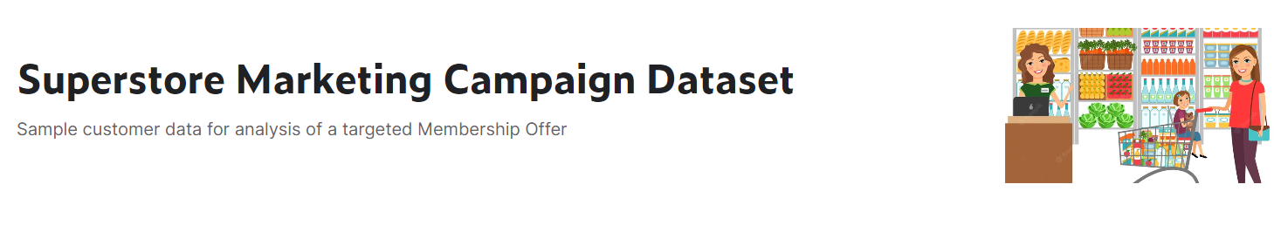
Data Source
Source:
Kaggle.com
Link:
https://www.kaggle.com/datasets/ahsan81/superstore-marketing-campaign-dataset

Slide 5
Data Description - Overall
2240 Observations
22 Variables
No duplicated rows
Some outliers in MntMeatProducts, NumWebPurchases, NumCatalogPurchases, Income and Age.
24 Missing Values in Income (1.07% Missing)

Slide 6
Customer Information Variables (1)
Response (target): 1 - Accept Offer. 0 - Declined Offer.
ID: Unique ID of each customer.
Birth Year: Year of Birth of the customer. (Converted to age).
Customer Date: Date the customer made a profile (Converted to days joined before 2015)
Education: Basic, Second Cycle, Graduation, Master, PhD
Marital Status: Single, Together, Married, Divorced, Other

Slide 7
Customer Information Variables (2)
Income: $1730 - $666,666
Kidhome: Number of children in the household (0, 1, 2)
Teenhome: Number of teens in the household (0, 1, 2)
Complain: 1 - customer complained within the last 2 years
Recency: number of days since last purchase

Slide 8
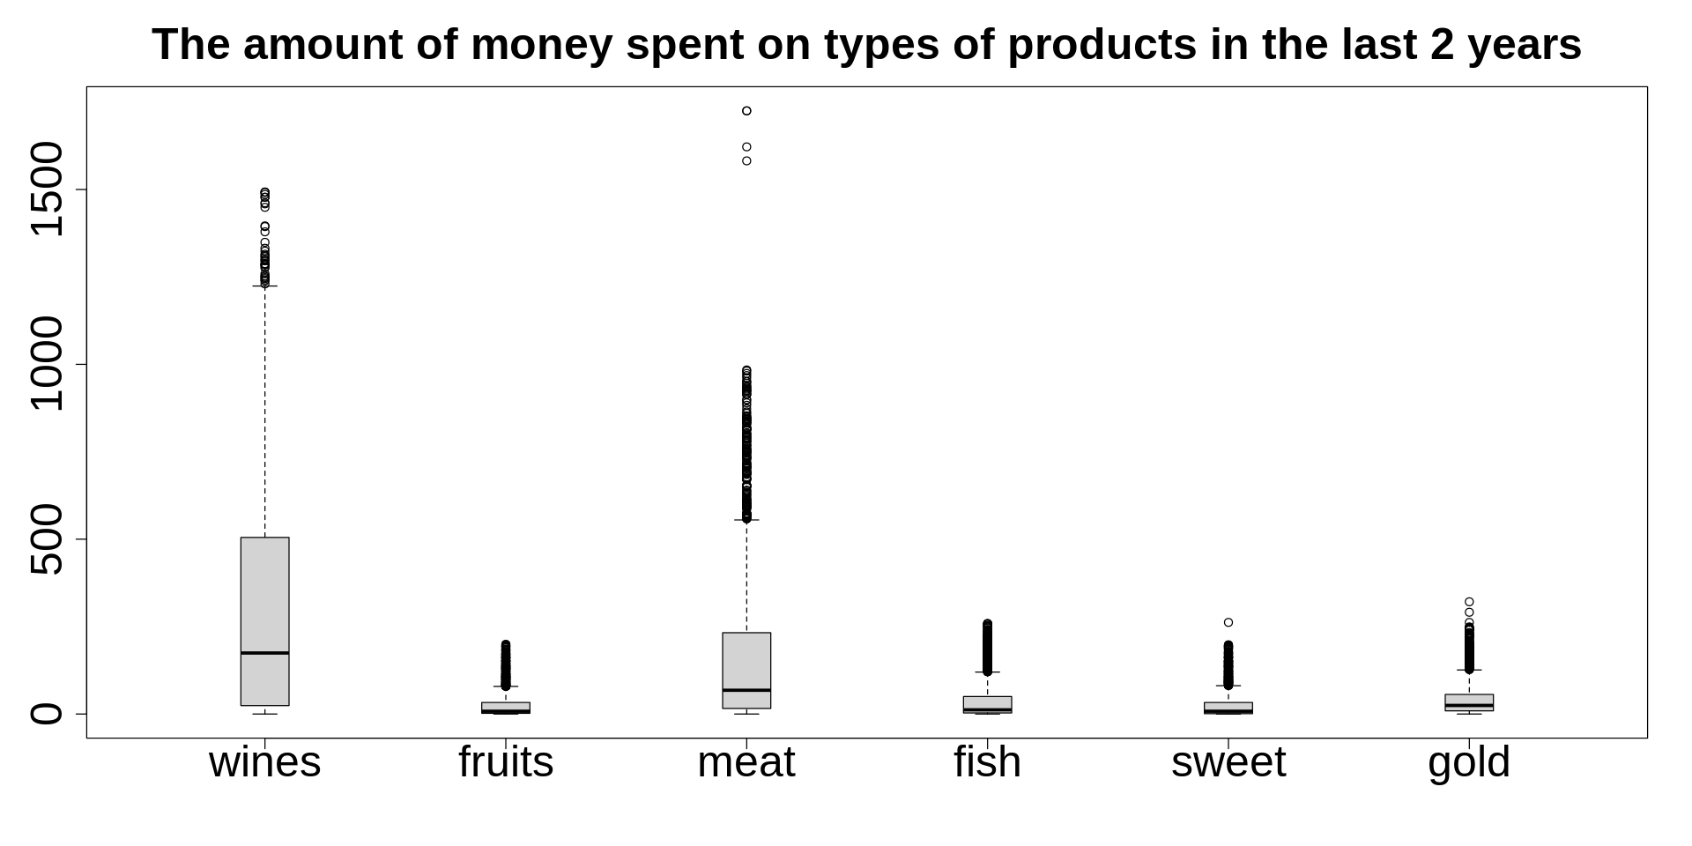
Amount Spent On:

Slide 9
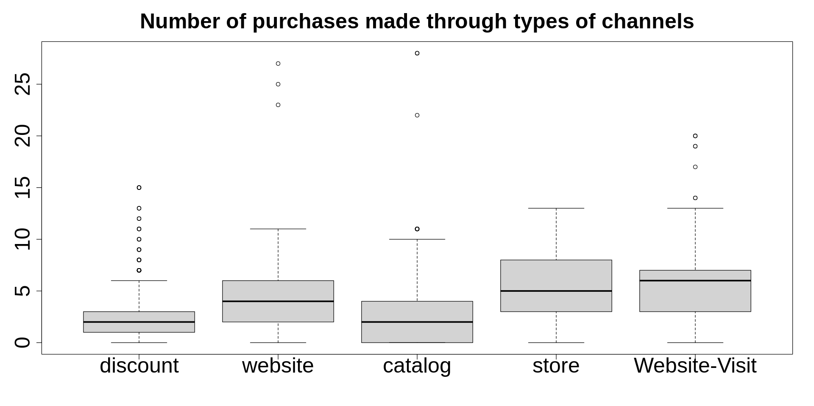
Number of Purchases

Slide 10
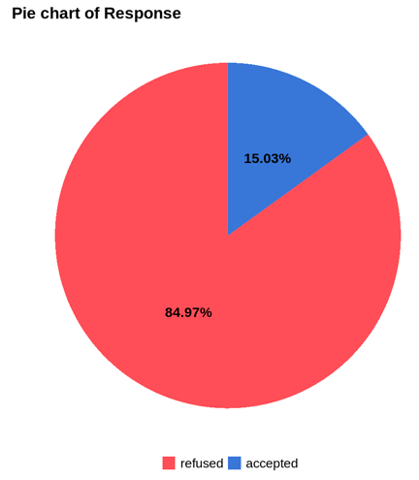
Possible Bias 1 - Unbalanced Dataset

Slide 11

Possible Bias 2 - Measurement Bias

Slide 12

Possible Bias 3 - Exclusion Bias

Slide 13
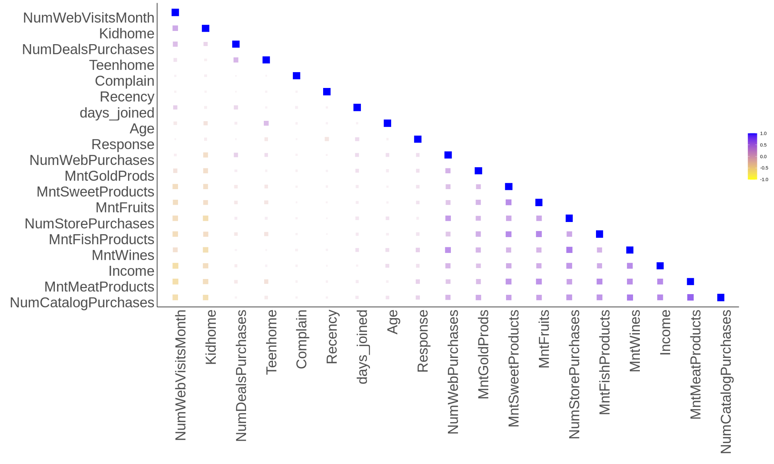
Correlation Matrix

Slide 14
Project Objectives
1. Visualize data with clustering techniques
2. Examine the clusters’ association with the customer profiles (education level, marital status, complain).
3. Use stepwise regression to predict the likelihood of positive customer response to the marketing campaign.

Slide 15
LITERATURE REVIEW

Slide 16
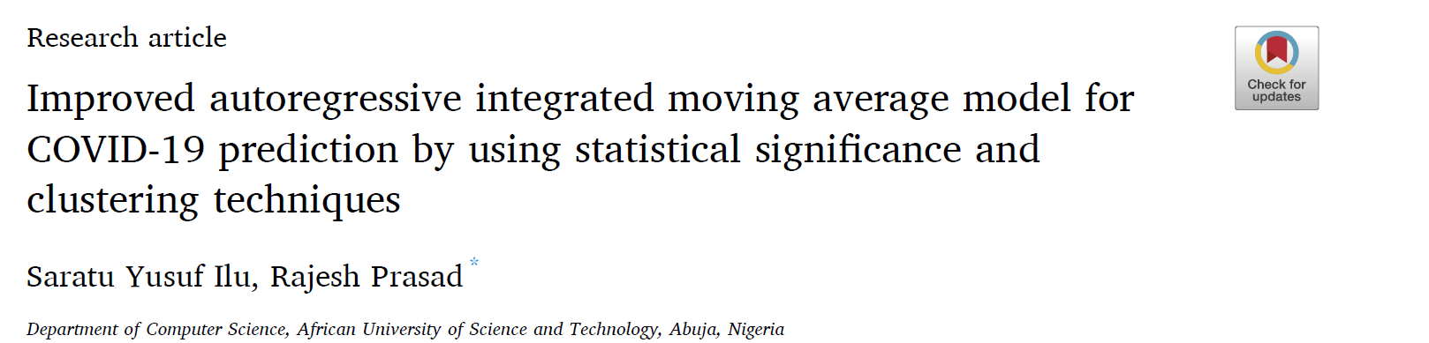
The Paper

Slide 17
Summary
Ilu and Prasad built an improved AutoRegressive Integrated Moving Average (ARIMA) model that takes in worldwide daily COVID-19 time-series data to predict cumulative COVID-19 cases.
The Improved ARIMA model has two additional processes:
Feature Selection (Statistical Significance Method)
K-means Clustering for outlier detection
Result: Improved ARIMA model achieved an accuracy rate of 97.75% whereas the standalone ARIMA model achieved an accuracy rate of 93%

Slide 18
ANALYSIS
Clustering Algorithm Selection
Hierarchical Clustering
CLARA
Advanced Clustering
Further Statistical Analysis

Slide 19
Clustering Variables
"Income"
"MntWines"
"MntFruits"
"MntMeatProducts"
"MntFishProducts"
"MntSweetProducts"
"MntGoldProds"
"NumDealsPurchases"
"NumWebPurchases"
"NumCatalogPurchases"
"NumStorePurchases"
"NumWebVisitsMonth"
"Age"
"days_joined"

Slide 20
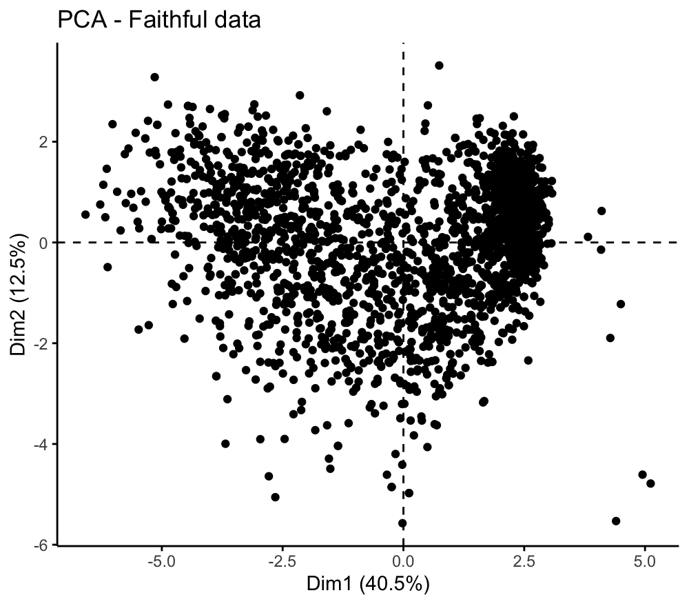
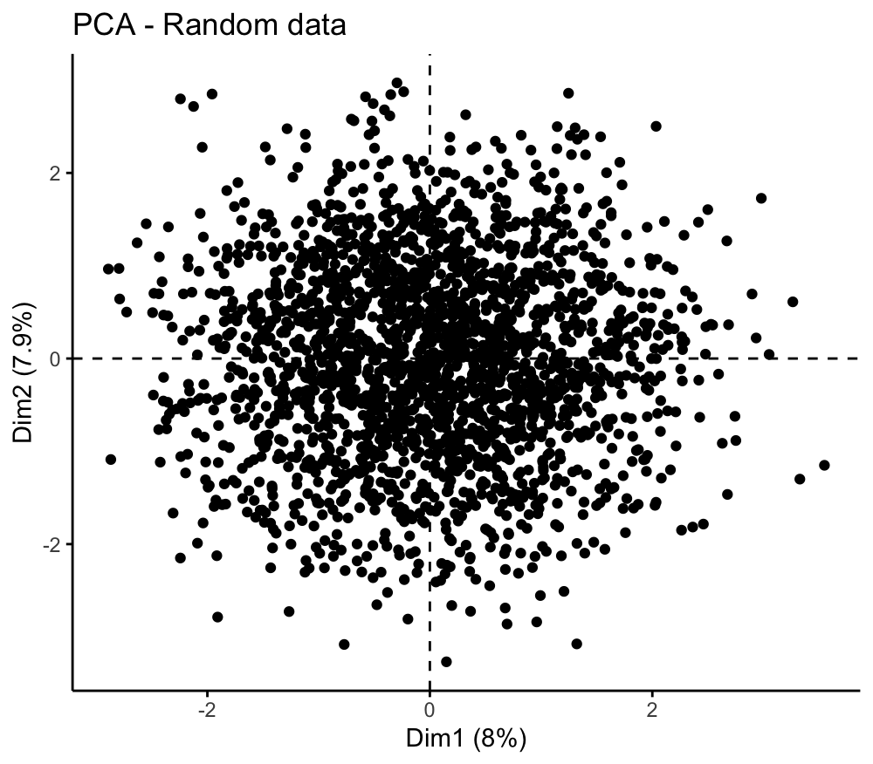
Clustering Algorithm Selection
Assessing Clustering Tendency
Visual inspection
Superstore Data
Random Data

Slide 21
Clustering Algorithm Selection
Assessing Clustering Tendency
Hopkins Statistic method
0.8915371
0.5009627
Superstore data
Random data

Slide 22
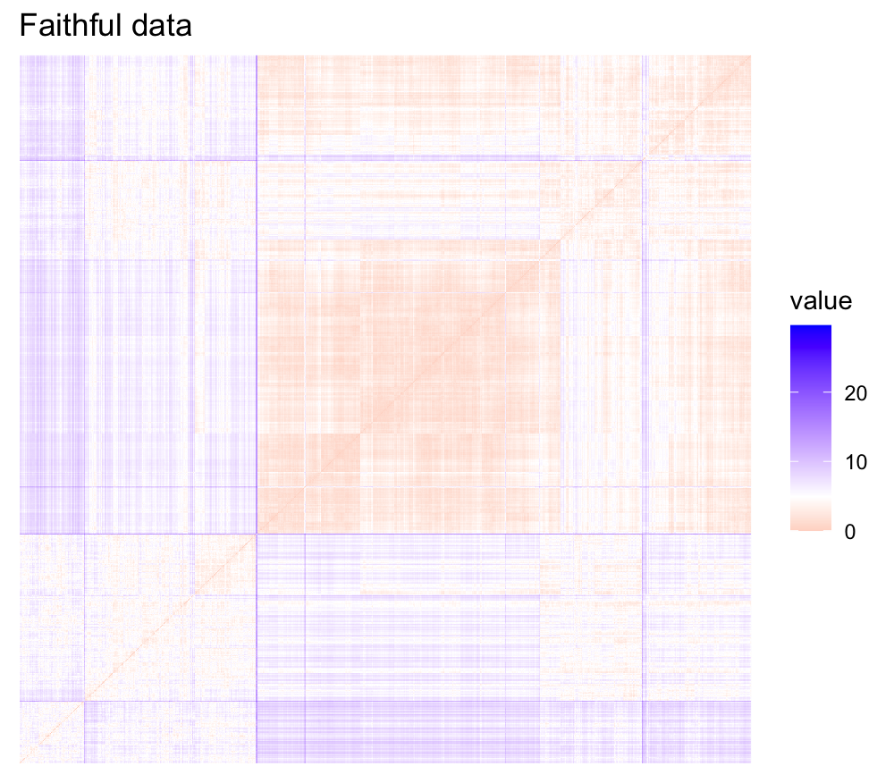
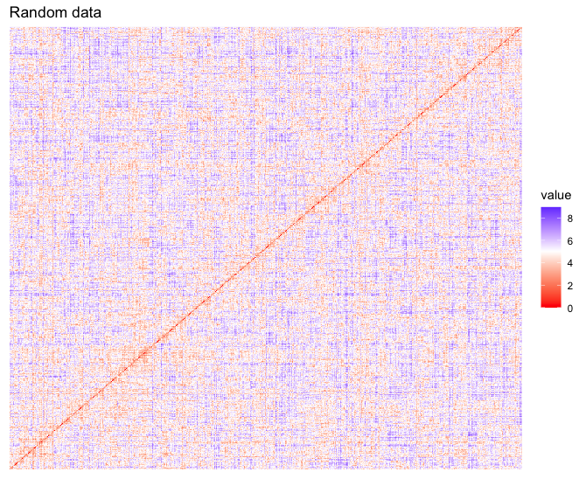
Clustering Algorithm Selection
Assessing Clustering Tendency
Visual method
Superstore data
Random data

Slide 23
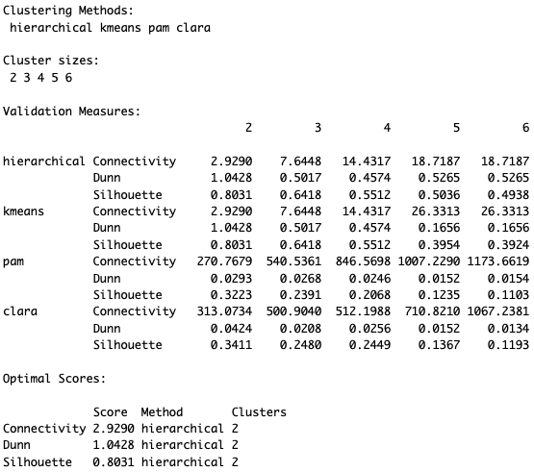
Clustering Algorithm Selection
Observations:
Outliers -> K-means may not be appropriate (sensitive to outliers)
A large number of data -> Clara may be better than PAM
Internal Measures:
Connectedness
– between 0 and infinity
– should be minimized
Silhouette Coefficient
– between -1 and 1
– should be maximized
Dunn index
– between 0 and infinity
– should be maximized

Slide 24
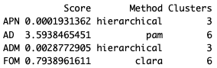
Clustering Algorithm Selection
Stability Measures:
APN & ADM:
Hierarchical clustering with 3 clusters gives the best score.
AD:
PAM with 6 clusters has the best score.
FOM:
Clara with 6 clusters has the best score.

Slide 25
Hierarchical Clustering
To check if the clustering is valid, we compute the correlation between the cophenetic distances and the original distances in the distance matrix. The closer the value of correlation coefficient is to 1, the more accurately the clustering solution reflects the data. Values above 0.75 are felt to be good.
Linkage Method Selection
 | Ward | Complete | Average
Correlation Coefficient | 0.60 | 0.77 | 0.85
We choose average method since it has the highest correlation coefficient.

Slide 26
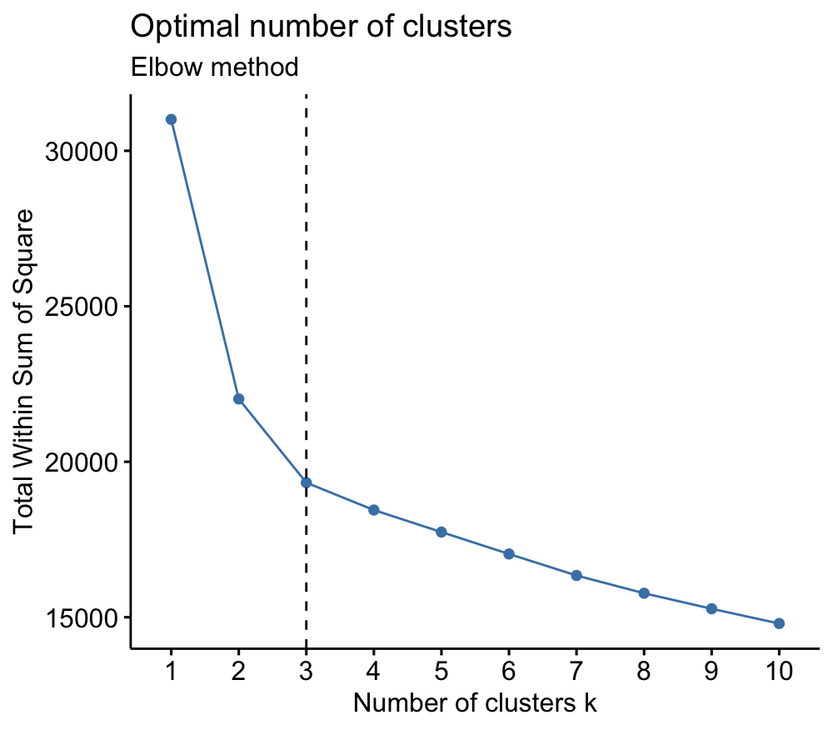
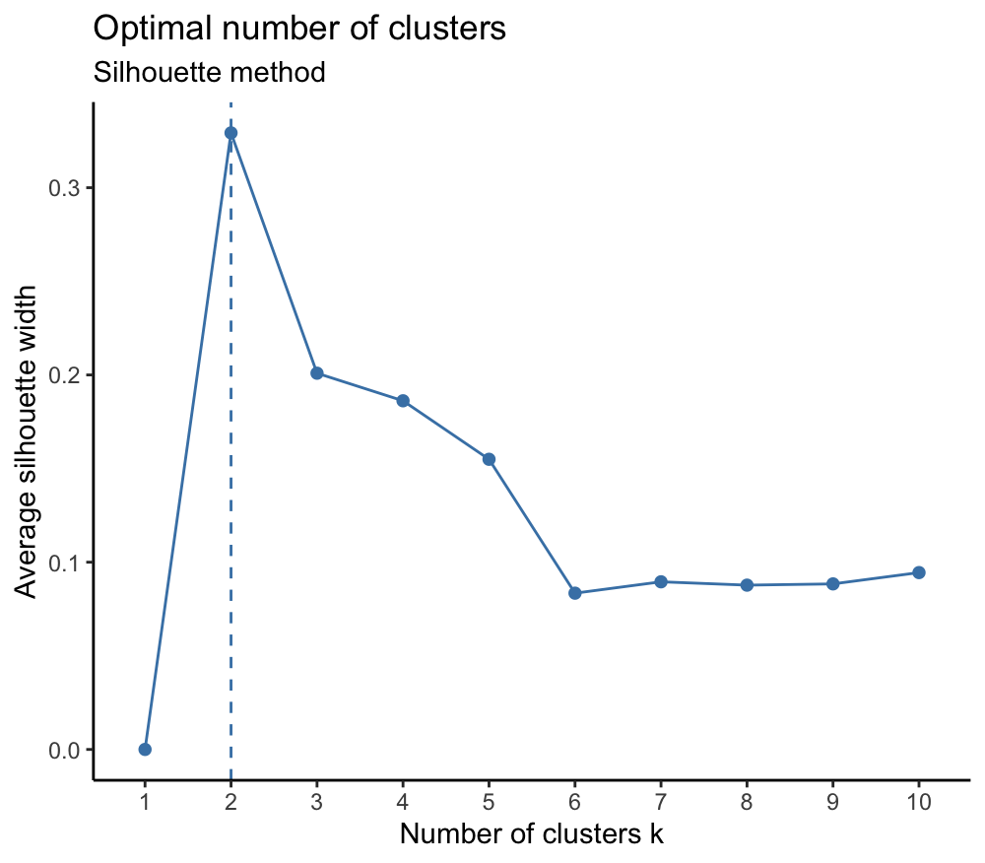
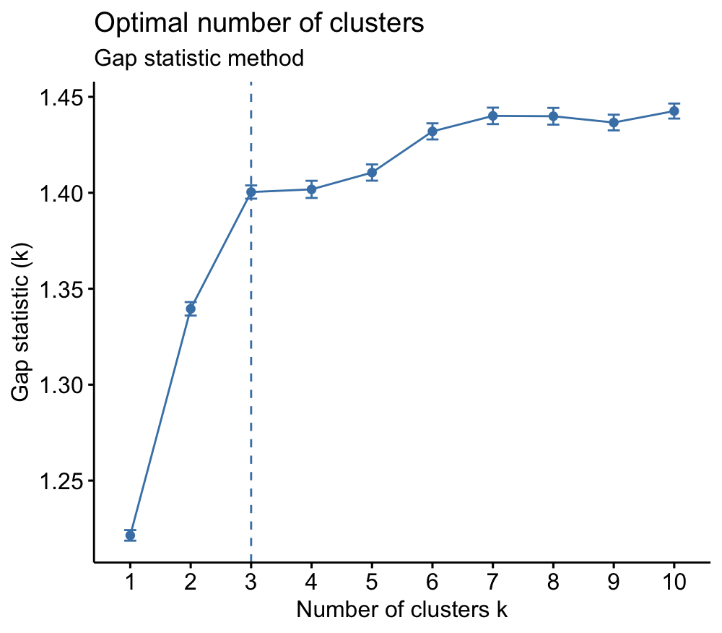
Hierarchical Clustering
Estimating the optimal number of clusters
Method | Optimal Number of Clusters
Elbow | 3
Silhouette | 2
Gap Statistic | 3

Slide 27
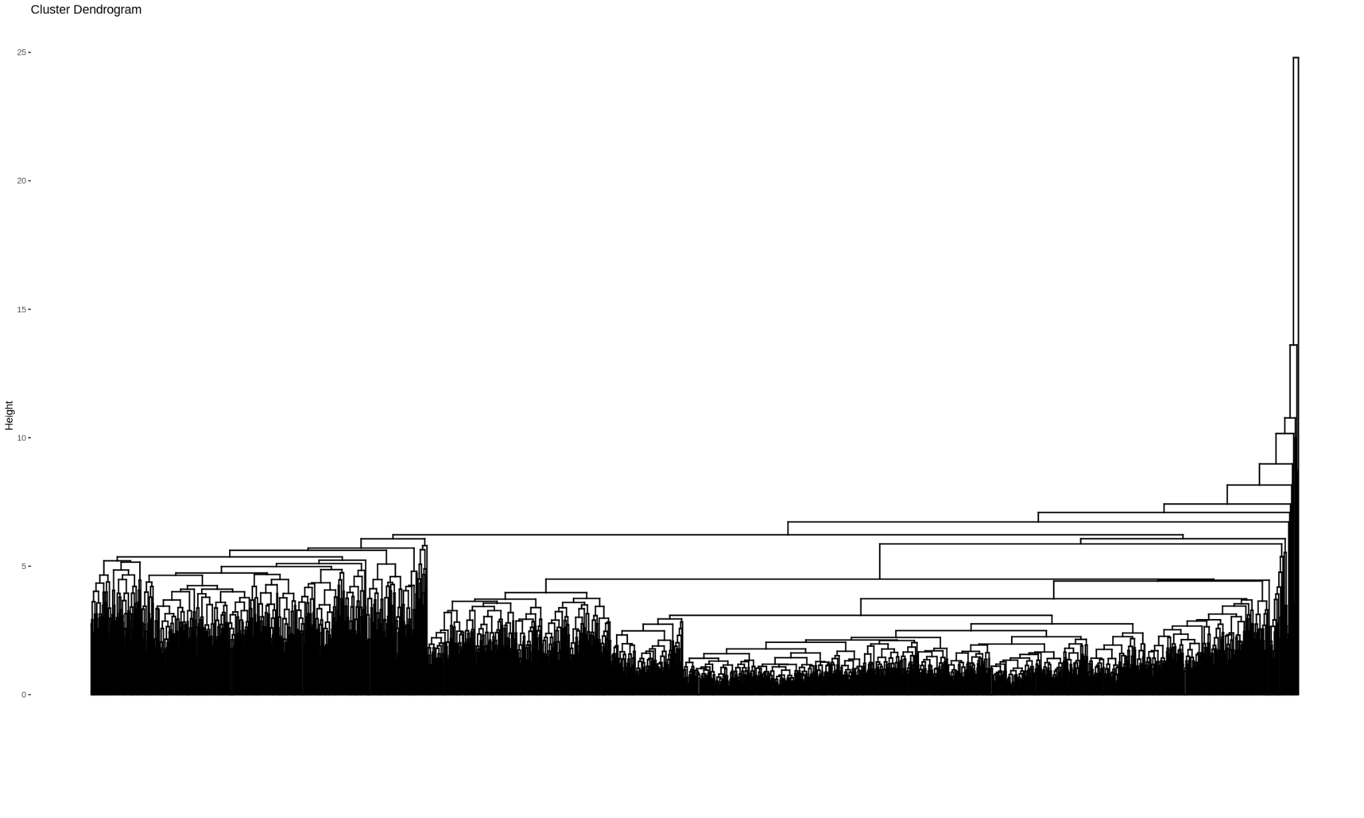
Hierarchical Clustering
Dendrogram

Slide 28
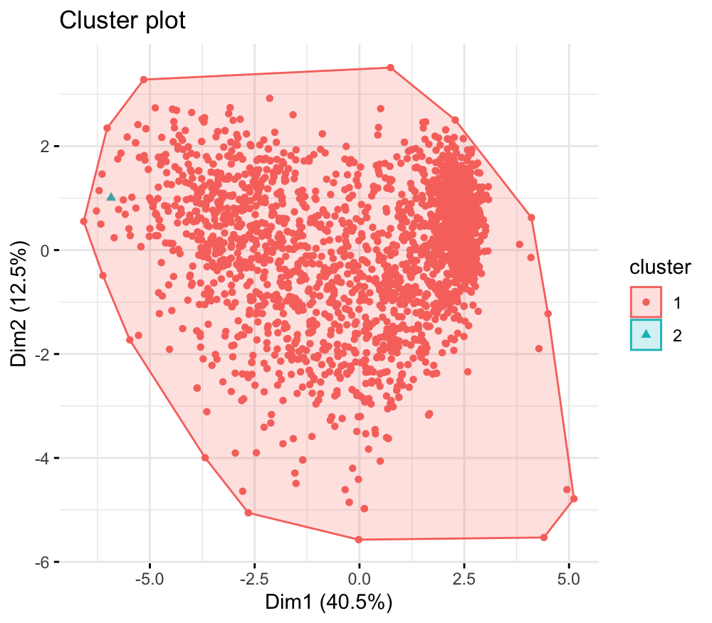
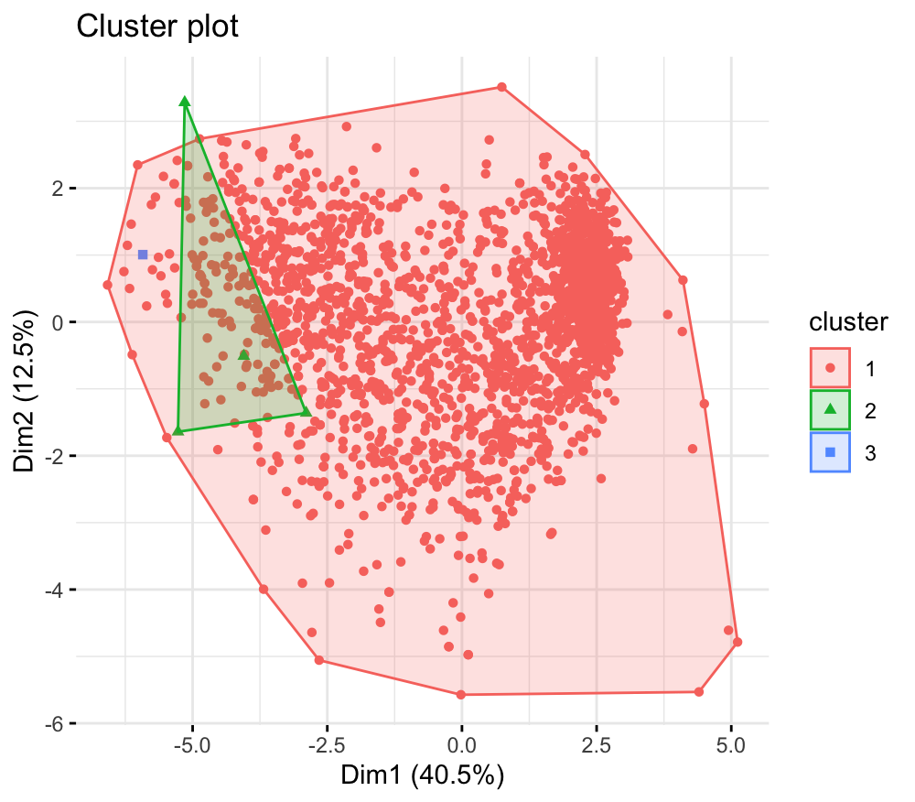
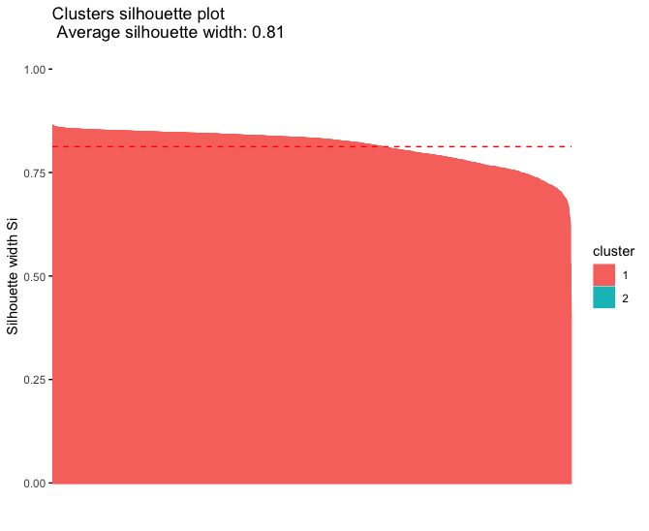
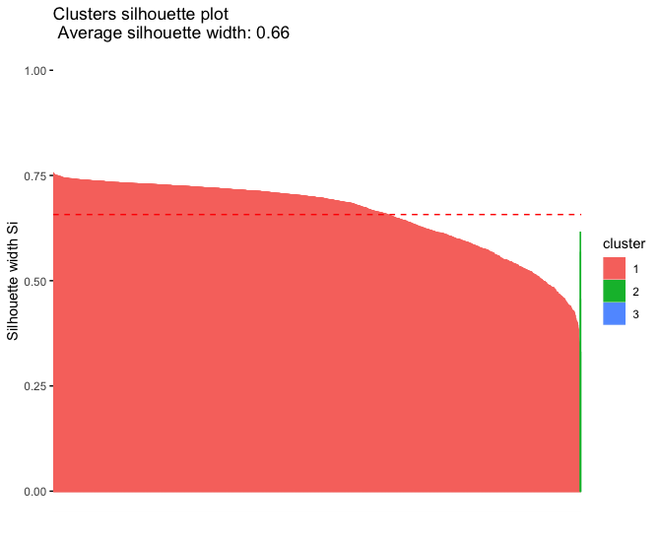
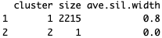
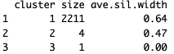
Hierarchical Clustering
K = 2
K = 3

Slide 29
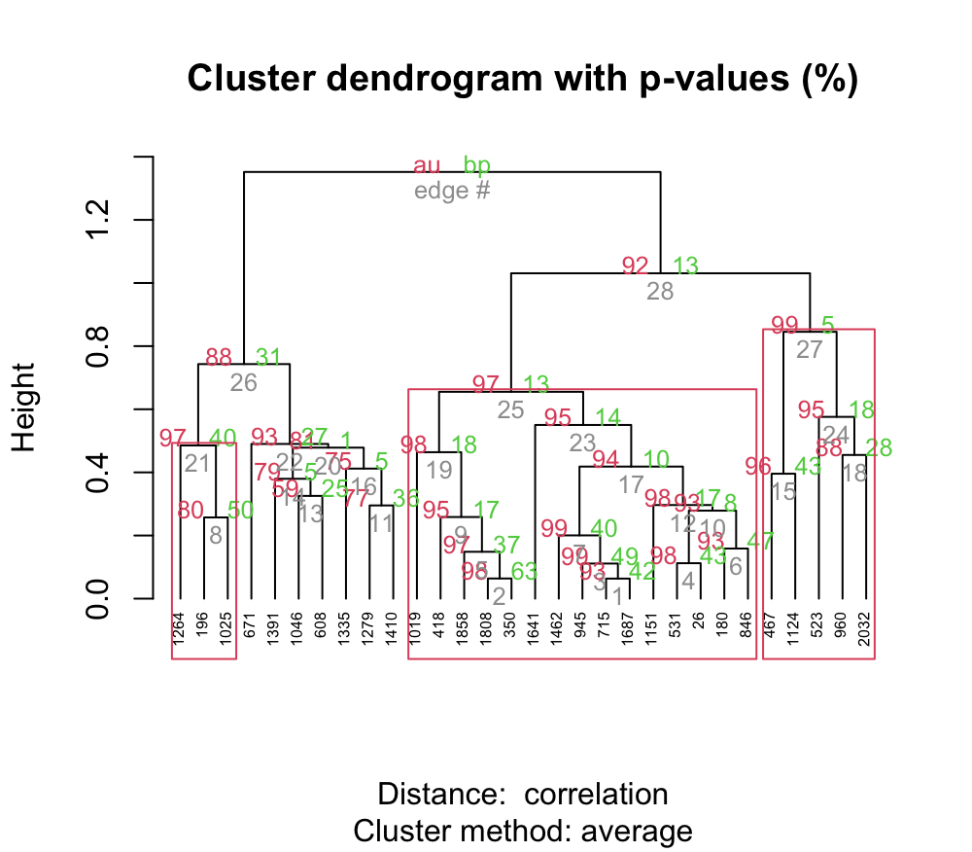
Hierarchical Clustering
Bootstrap Sampling: 30 samples

Slide 30
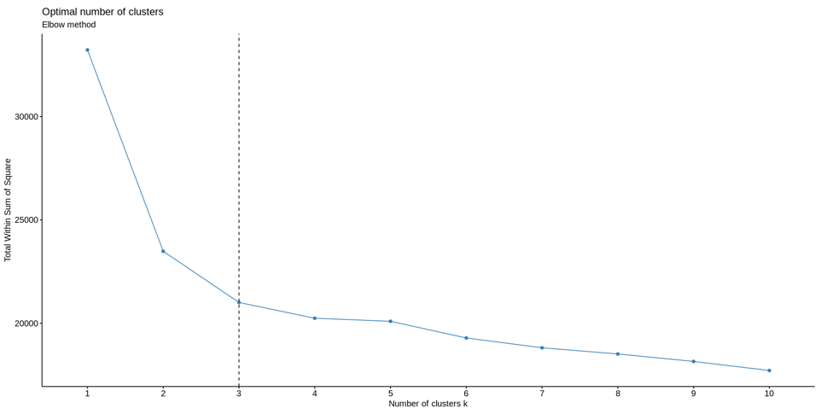
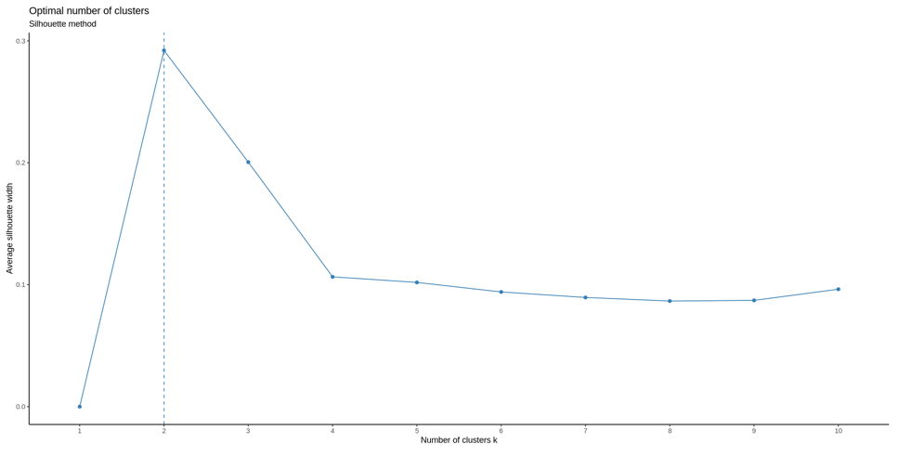
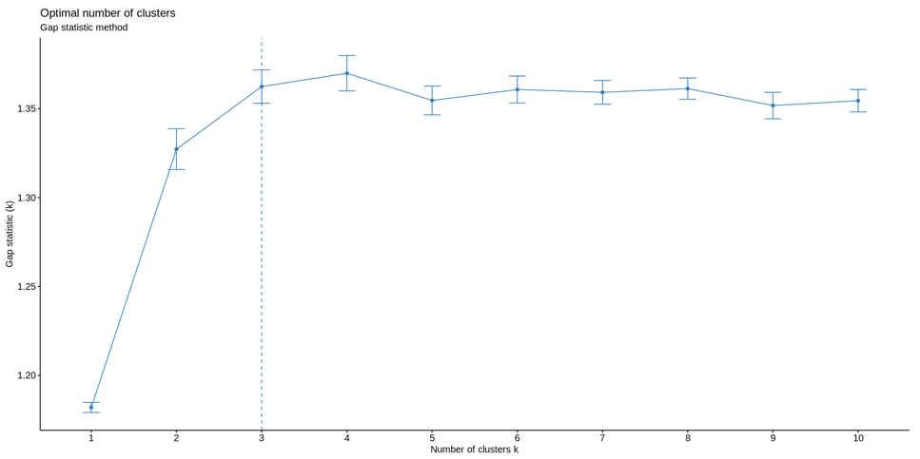
CLARA
Optimal Number of Clusters
Method | Optimal Number of Clusters
Elbow | 3
Silhouette | 2
Gap Statistic | 3

Slide 31
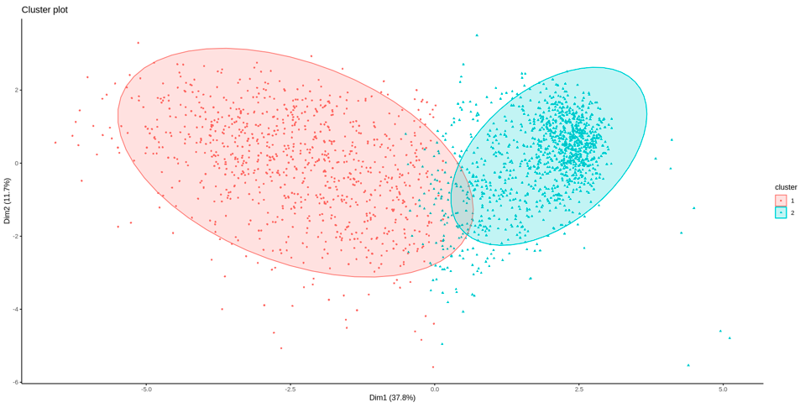
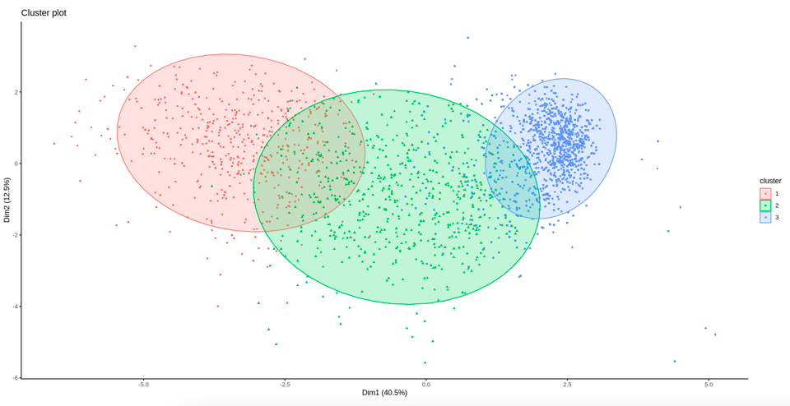
CLARA
K = 2
K = 3

Slide 32
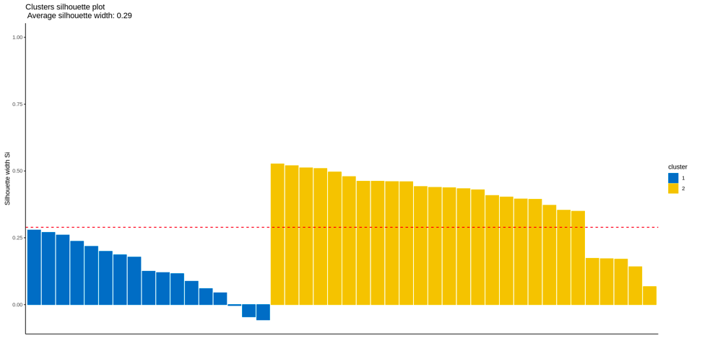
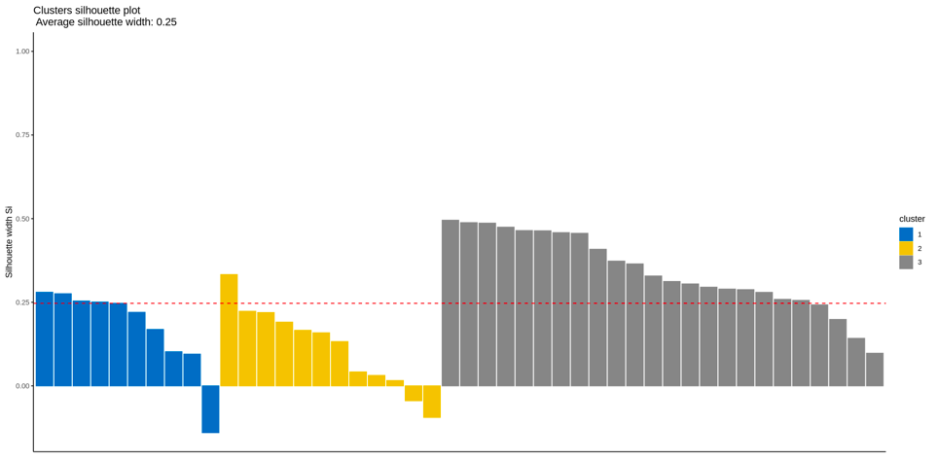
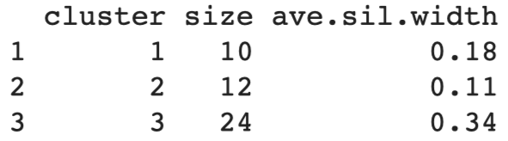
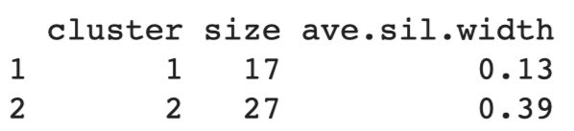
CLARA
Internal Validation - Silhouette (Si) Coefficient
K = 2
K = 3

Slide 33
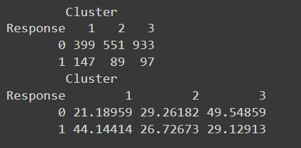
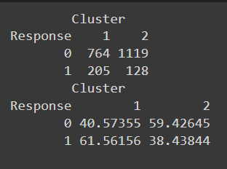
CLARA
Internal Validation - Dunn Index
Number of Clusters | Dunn
2 | 0.0293
3 | 0.0261
External Validation - Corrected Rand Index & Meila’s Variation Index VI
Number of Clusters | Corrected Rand | Meila’s VI
2 | 0.0303 | 1.0857
3 | 0.0396 | 1.4469
Notes:
Dunn: similarly low value → same goodness of clustering level
Rand

Slide 34
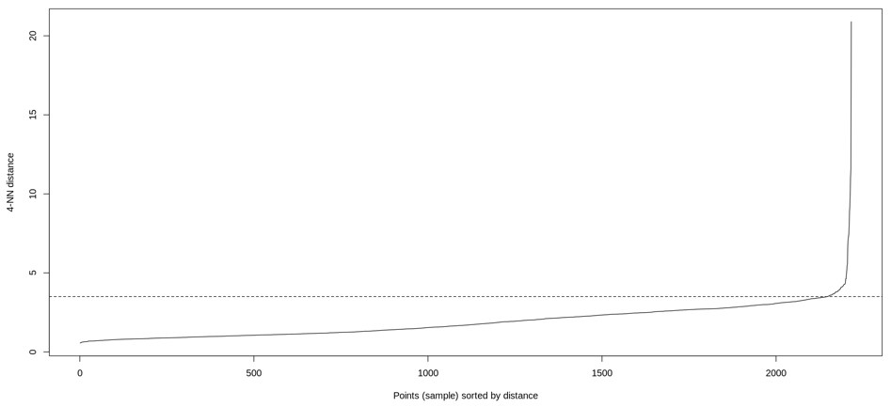
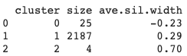
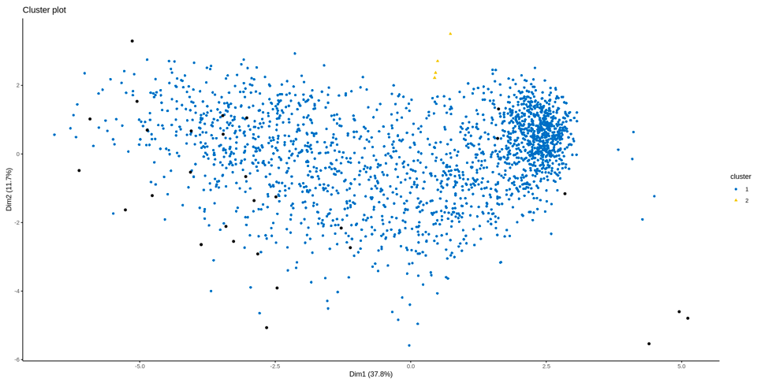
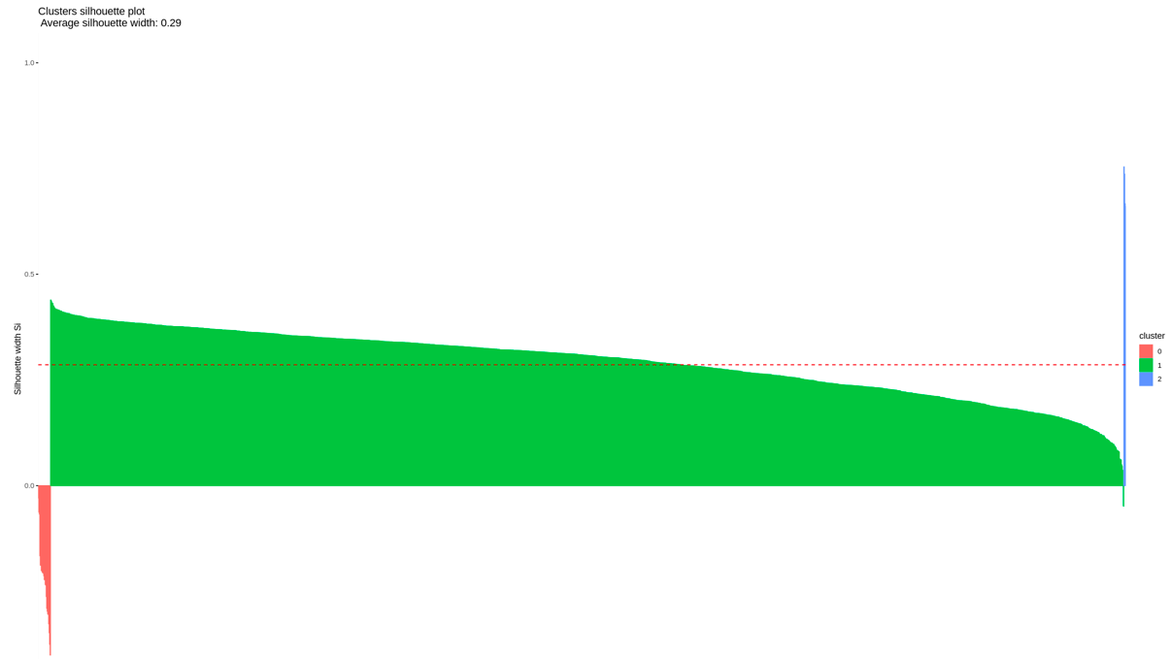
DBSCAN
epsilon = 3.5
MinPts = 4

Slide 35
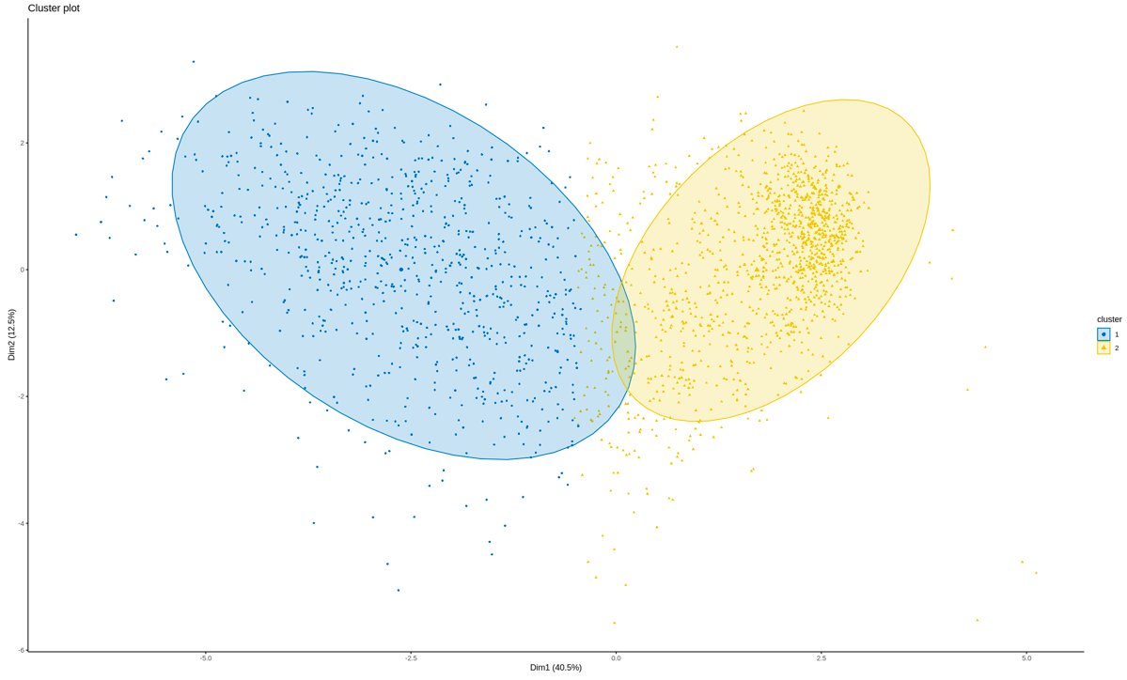
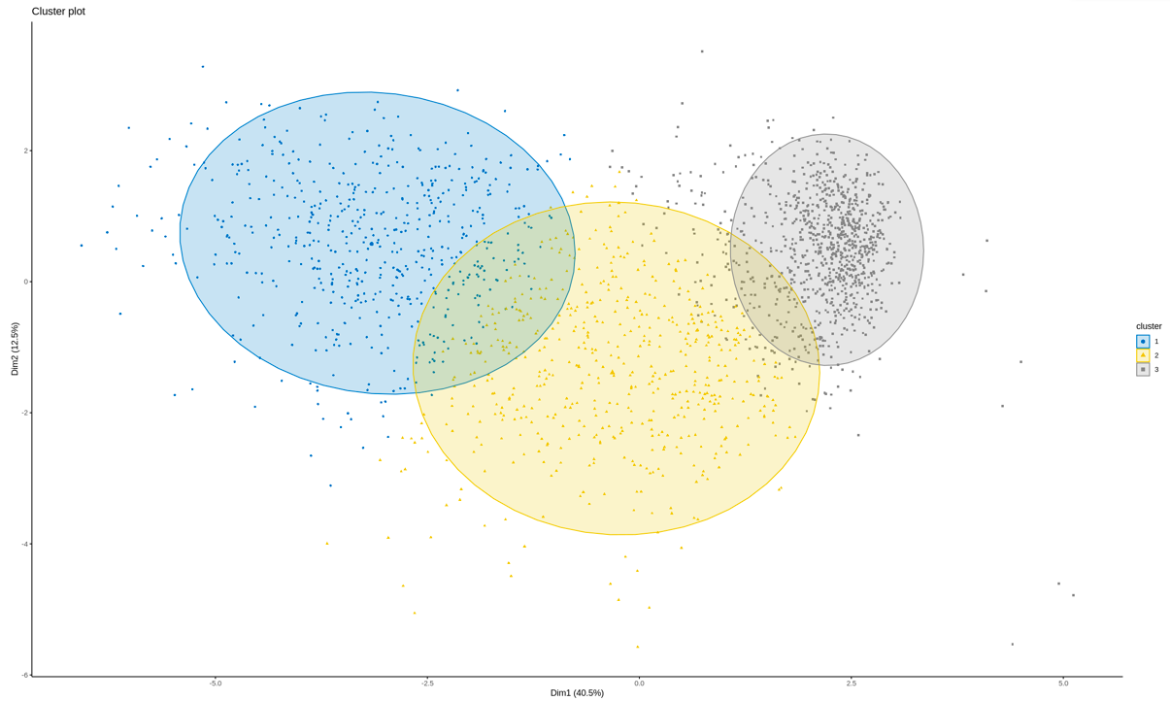
Hierarchical K-means Clustering
K = 2
K = 3

Slide 36
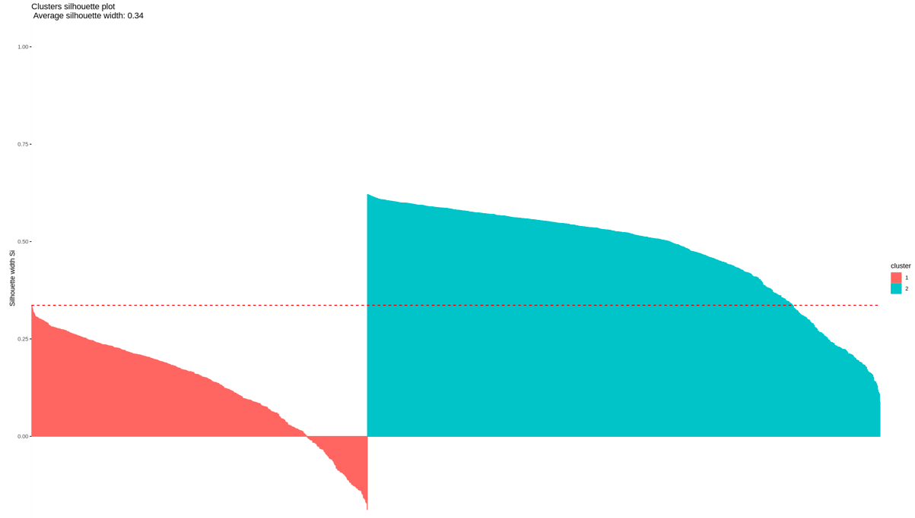
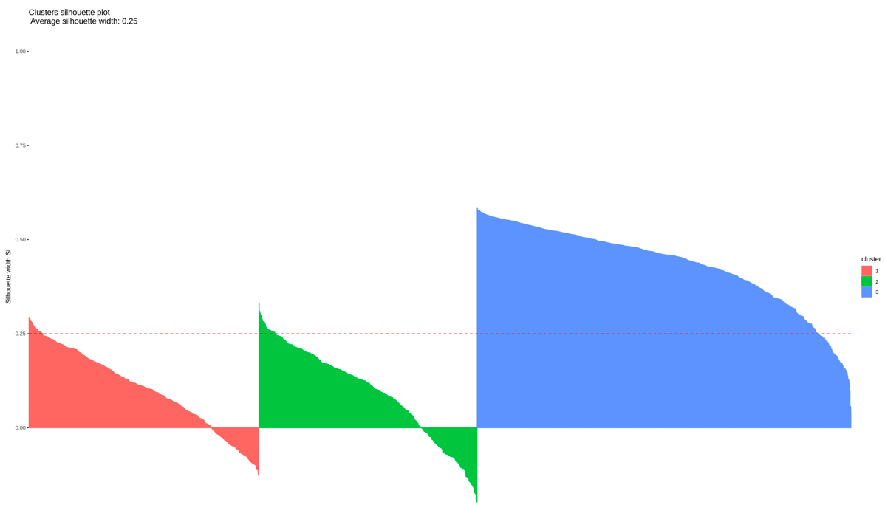
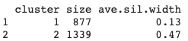
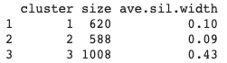
Hierarchical K-means Clustering
Internal Validation - Silhouette (Si) Coefficient
K = 2
K = 3

Slide 37
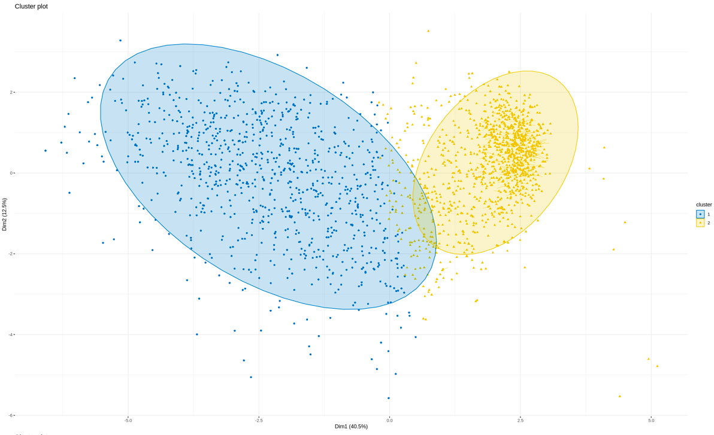
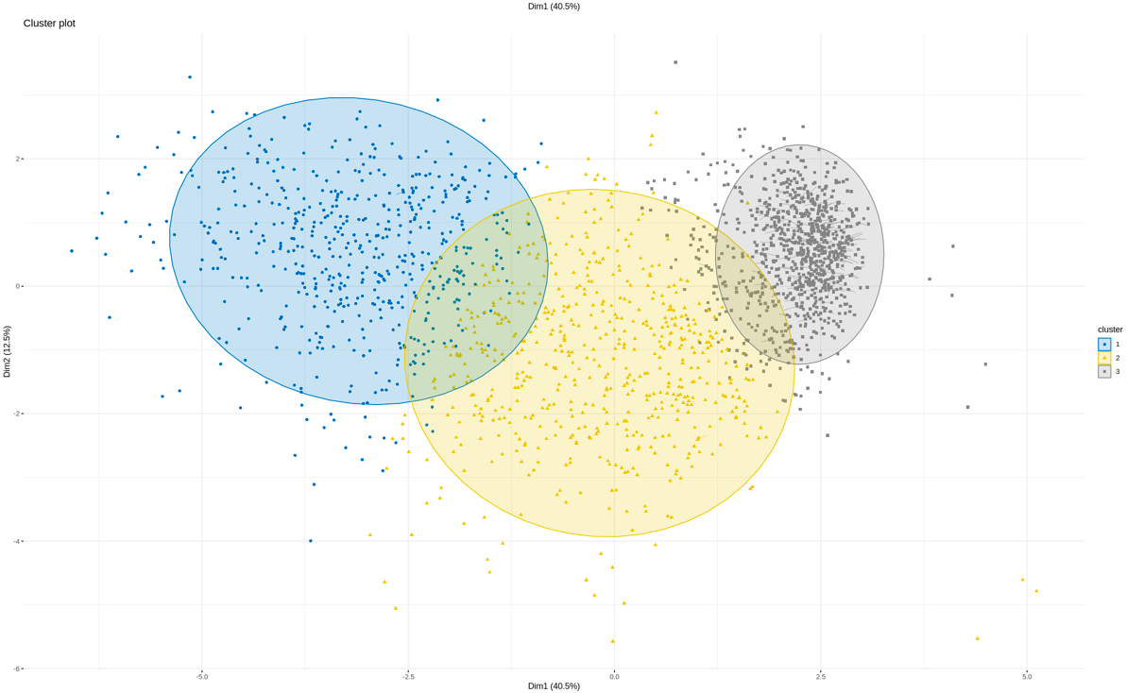
Fuzzy Clustering
K = 2
K = 3

Slide 38
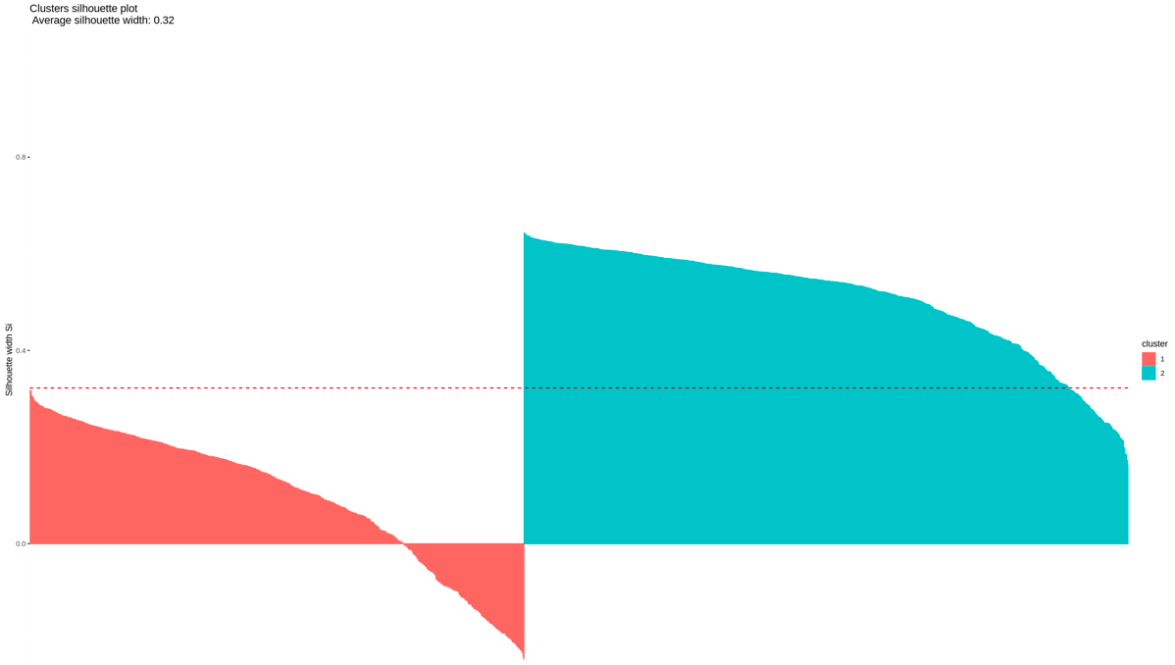
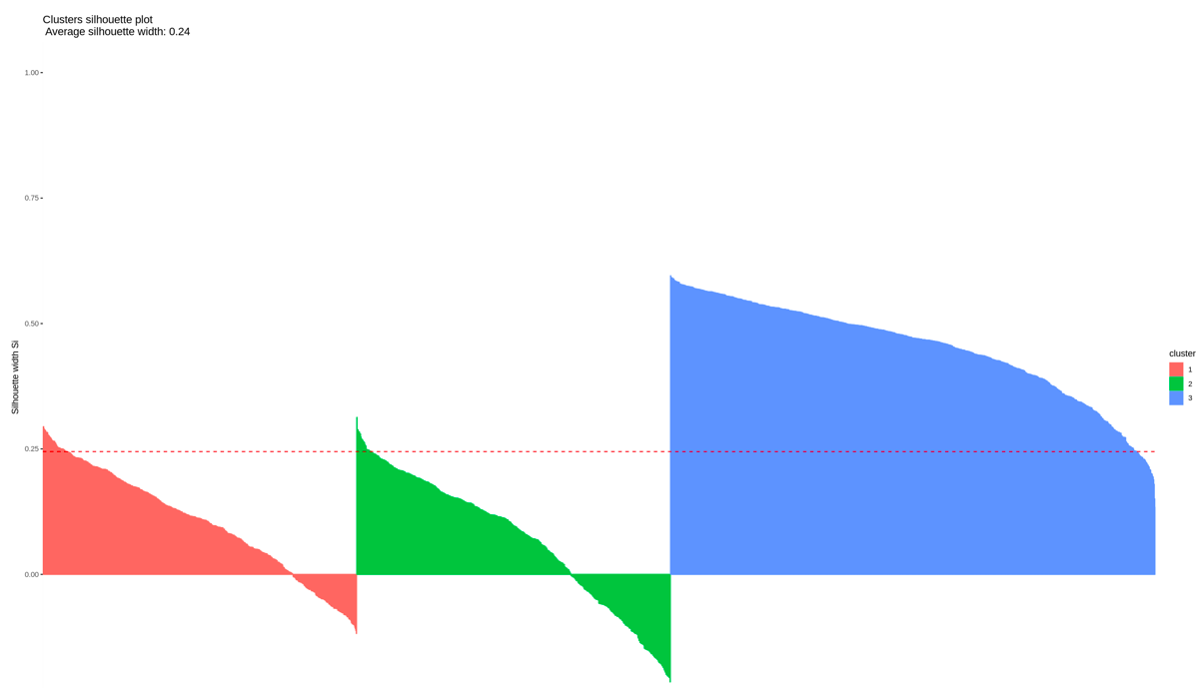
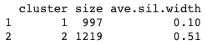
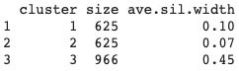
Fuzzy Clustering
Internal Validation - Silhouette (Si) Coefficient
K = 2
K = 3

Slide 39
Further Statistical Analysis
Explore and analyse the dataset using stepwise logistic regression model and compare the clusters with categorical variables.
Stepwise regression:
Split the dataset into 70% training and 30% testing dataset
Use training dataset to fit the model, predict the response using testing dataset
Compare the model with and without clustering label
Compare clusters with categorical variables
Compare the distribution and average of response, kidshome and marital status with clustering group

Slide 40



Stepwise Logistic Regression
With “clustering labels” in the model
Without “clustering labels” in the model

Slide 41


Stepwise Logistic Regression
With “clustering labels” in the model
Without “clustering labels” in the model
“Clustering labels” are statistically significant to the model, but do not improve the accuracy

Slide 42
Distribution of Clusters in Categorical Variables
Variable | Cluster 1 | Cluster 2
Response:
Accepted | 61.56% | 38.44%
Refused | 40.57% | 59.43%
Marital Status:
Married / Together | 43.21% | 56.78%
Others | 44.65% | 55.34%
Kids Status:
With kids at home | 68.98% | 31.02%
Without kids at home | 9.00% | 91.00%
Variable | Cluster 1 | Cluster 2
Teens Status:
With teens at home | 47.17% | 52.83%
Without teens at home | 40.04% | 59.96%
Education:
Basic Education / Graduation | 43.42% | 56.58%
Higher Education | 44.07% | 55.93%

Slide 43


Distribution of Clusters in Categorical Variables
Variable : Kidhome
Family with kids / without kids is associated with cluster labels

Slide 44
CONCLUSION

Slide 45
Conclusion
Clustering tendency of the dataset is verified. Clustering is appropriate for this dataset.
Hierarchical clustering may not be appropriate for this dataset, even though it's the best algorithm recommended.
CLARA, hierarchical k-means and fuzzy k-means clustering are the preferred methods. 2 clusters is better for the dataset.
A summary table of customer profile grouped by cluster has been created. Average kidhome in the two clusters vary greatly.
By using the cluster label, the accuracy of our logistic regression model slightly decreased from 86.6% to 85.9%.
Possible Improvements: use hierarchical clustering for outlier detection.

Slide 46
Q&A

Slide 47
References
Ilu, Saratu Yusuf, and Rajesh Prasad. “Improved Autoregressive Integrated Moving Average Model for COVID-19 Prediction by Using Statistical Significance and Clustering Techniques.” Heliyon 9, no. 2 (February 1, 2023). doi:10.1016/j.heliyon.2023.e13483.
https://www.telusinternational.com/insights/ai-data/article/7-types-of-data-bias-in-machine-learning
https://elearningindustry.com/7-benefits-of-mistake-driven-learning
https://www.mamamia.com.au/how-to-type-shrug/

Slide 48
Contributions
Florence Cheng (25%)
Phuong-Mai Tran (25%)
Andrew Liu (25%)
Gene Xia (25%)

